Slide 1
Sample size calculation for survival analysis
05July 2021
Eamonn O’Brien

Slide 2
Time to event
Published example
Repeat using R function
Repeat using R simulation

Slide 3
A published study calculation
https://www.youtube.com/watch?v=fTKKaAy5jBs&ab_channel=Statsols%28ProviderofnQuery%29
“Using an unstratified log-rank test at the one-sided 2.5% significance level, a total of 282 events would allow 92.6% power to demonstrate a 33% risk reduction (hazard ratio for RAD/placebo of about 0.67, as calculated from an anticipated 50% increase in median PFS, from 6 months in placebo arm to 9 months in the RAD001 arm). With a uniform accrual of approximately 23 patients per month over 74 weeks and a minimum follow up of 39 weeks, a total of 352 patients would be required to obtain 282 PFS events, assuming an exponential progression-free survival distribution with a median of 6 months in the Placebo arm and of 9 months in RAD001 arm. With an estimated 10% lost to follow up patients, a total sample size of 392 patients should be randomized.”

Slide 4
1 R function approach

Slide 5
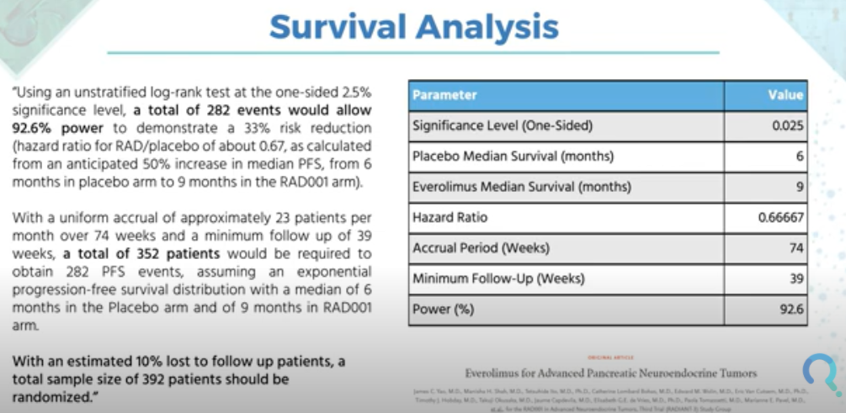
Published example cont’d
Note inconsistent units for time, mix of months and weeks. Need to use a consistent unit.

Slide 6
Time to event
It is the number of events that is important not the number of subjects

Slide 7
We are informed ‘assuming an exponential progression-free survival distribution’ [1]
The exponential distribution is the simplest possible parametric distribution for survival times
It is then relatively trivial to create the two assumed survival curves and understand differences

Slide 8
We are informed ‘assuming an exponential progression-free survival distribution’ [2]
We are told median survival of 6 months in control, so:
λ_{c}= -ln(0.5)/6 = ln(2)/6 = 0.1155 (constant hazard)
We are told median survival of 9 months in treated group, so:
λ_{T}= -ln(0.5)/9 = ln(2)/9 = 0.0770 (constant hazard)
Conventionally, for HRs (and ORs), the treatment group (T) is used in the numerator and the control group (C) in the denominator, so the HR = λ_{T} / λ_{c} = 0.0770 / 0.1155 = 2/3 as we are told.

Slide 9
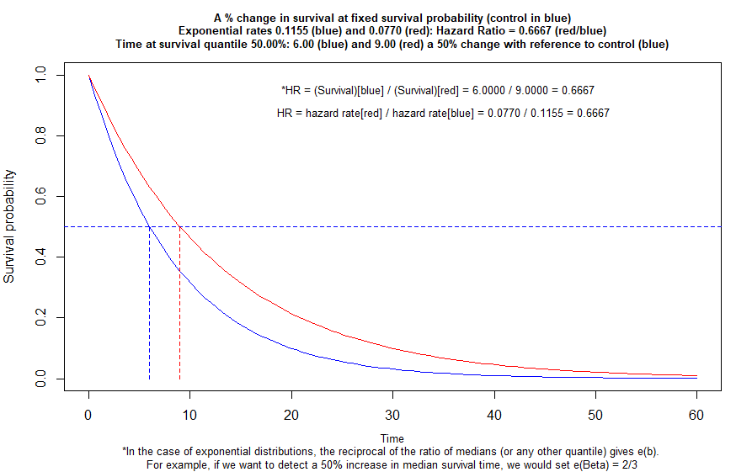
To help understand, draw exponential survival curves @ fixed survival probability [1]
Use supplied information at fixed survival probability at 0.50 as stated in problem statement
See what the 2 hazards we calculated look like…
We can calculate the HR in two ways as shown in the text on the graph
Notes:
survplot4( CSurvProp=.5, time1=6, surv.perc.change.improvement=50 )

Slide 10
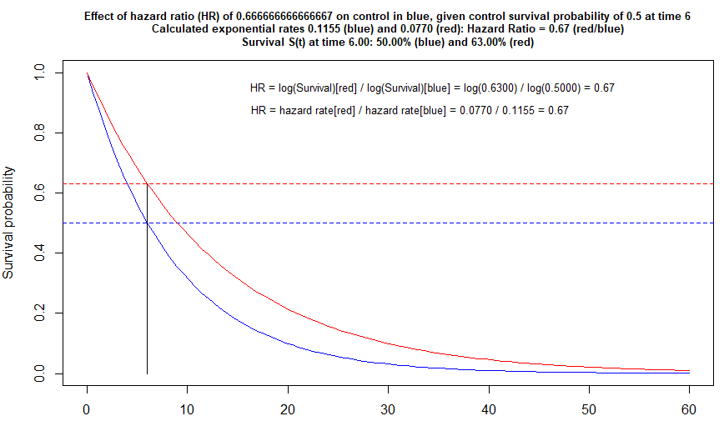
Another perspective, draw exponential curves @ fixed survival time [2]
Fix survival probability at 6 months as stated in problem statement
See what the 2 hazards we calculated look like…
We can calculate the HR in two ways as shown in the text on the graph
Notes:
survplot3( CSurvProp=.5, time1=6, HR=2/3 )

Slide 11
Function in Hmisc R package to calculate power
This attacks the problem from a fixed survival time [2] and asks for the probability of mortality, so calculate them.
Put all times on equal footing using the same units, as the problem statement has estimates in weeks and months!
We use the supplied ctrl mortality at 6 mths, the hypothesised mortality at 6 mths in trt’d, the accrual and follow up time and enter the total sample size to find the power.

Slide 12
CODE FOR ALL PLOTS AND CALCULATIONS IN THIS PRESENTATION

Slide 13
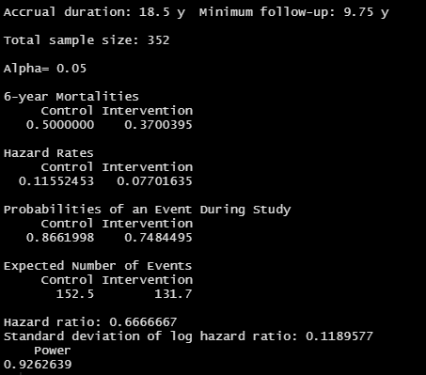
Function in Hmisc R package to calculate power
#~~~~~~~~~~~~~~~~~~~~~~~~~~~~~~~~~~~~~~~~~~~~~~~~~~~~~
# calculate hypothesised mortality
morti <- function ( d0=.5, hr=2/3, time=6){
lambda = -log(1-d0)/time # hazard rate
m = 1 - exp(-lambda*time*hr) # mortality hence subtracting from 1
return(m)
}
d0 <- 0.5 # control mortality at 6 months
d1 <- morti() # intervention mortality at 6 months
#~~~~~~~~~~~~~~~~~~~~~~~~~~~~~~~~~~~~~~~~~~~~~~~~~~~~~
# r is the % reduction ctrl to intervention
# mc is tref-year mortality, control
Hmisc::cpower(tref=6, n=352, mc=d0, r= 100*(d0 - d1)/d0,
tmin=39/4, accrual=74/4, alpha=.05, pr=TRUE,
noncomp.c = 0, noncomp.i = 0) # other options
#~~~~~~~~~~~~~~~~~~~~~~~~~~~~~~~~~~~~~~~~~~~~~~~~~~~~~~
R output:
Note: one sided 2.5% == two sided 5%
Agreement with Nquery
Notes:
Hmisc::cpower Power of Cox/log-rank Two-Sample Test

Slide 14
2 Simulation approach

Slide 15
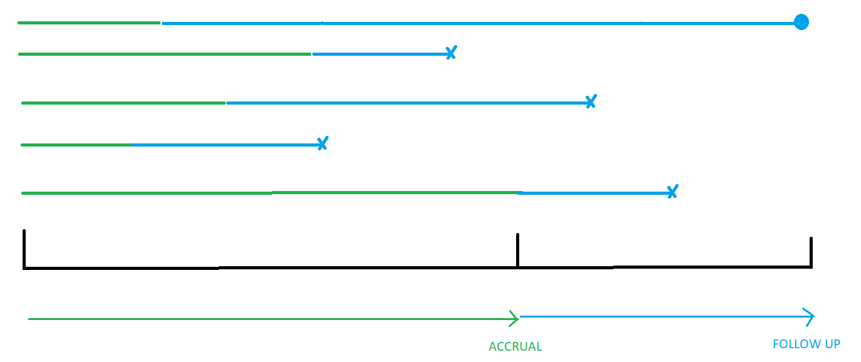
Simulation approach (most flexible)
1 Simulate random uniform variates from 0 to accrual time (green)
2 Simulate random exponential event times (blue) for each group
3 Calculate ‘new’ event times shown by cross
4 Ensure sum of green and blue is no bigger than accrual + follow up
5 Analyse, collect parameter estimates
6 Repeat 1-5 large number of times and summarise

Slide 16

Simulation results v Hmisc::cpower
GOOD AGREEMENT

Slide 17
THE END…Questions?

